Slide 1
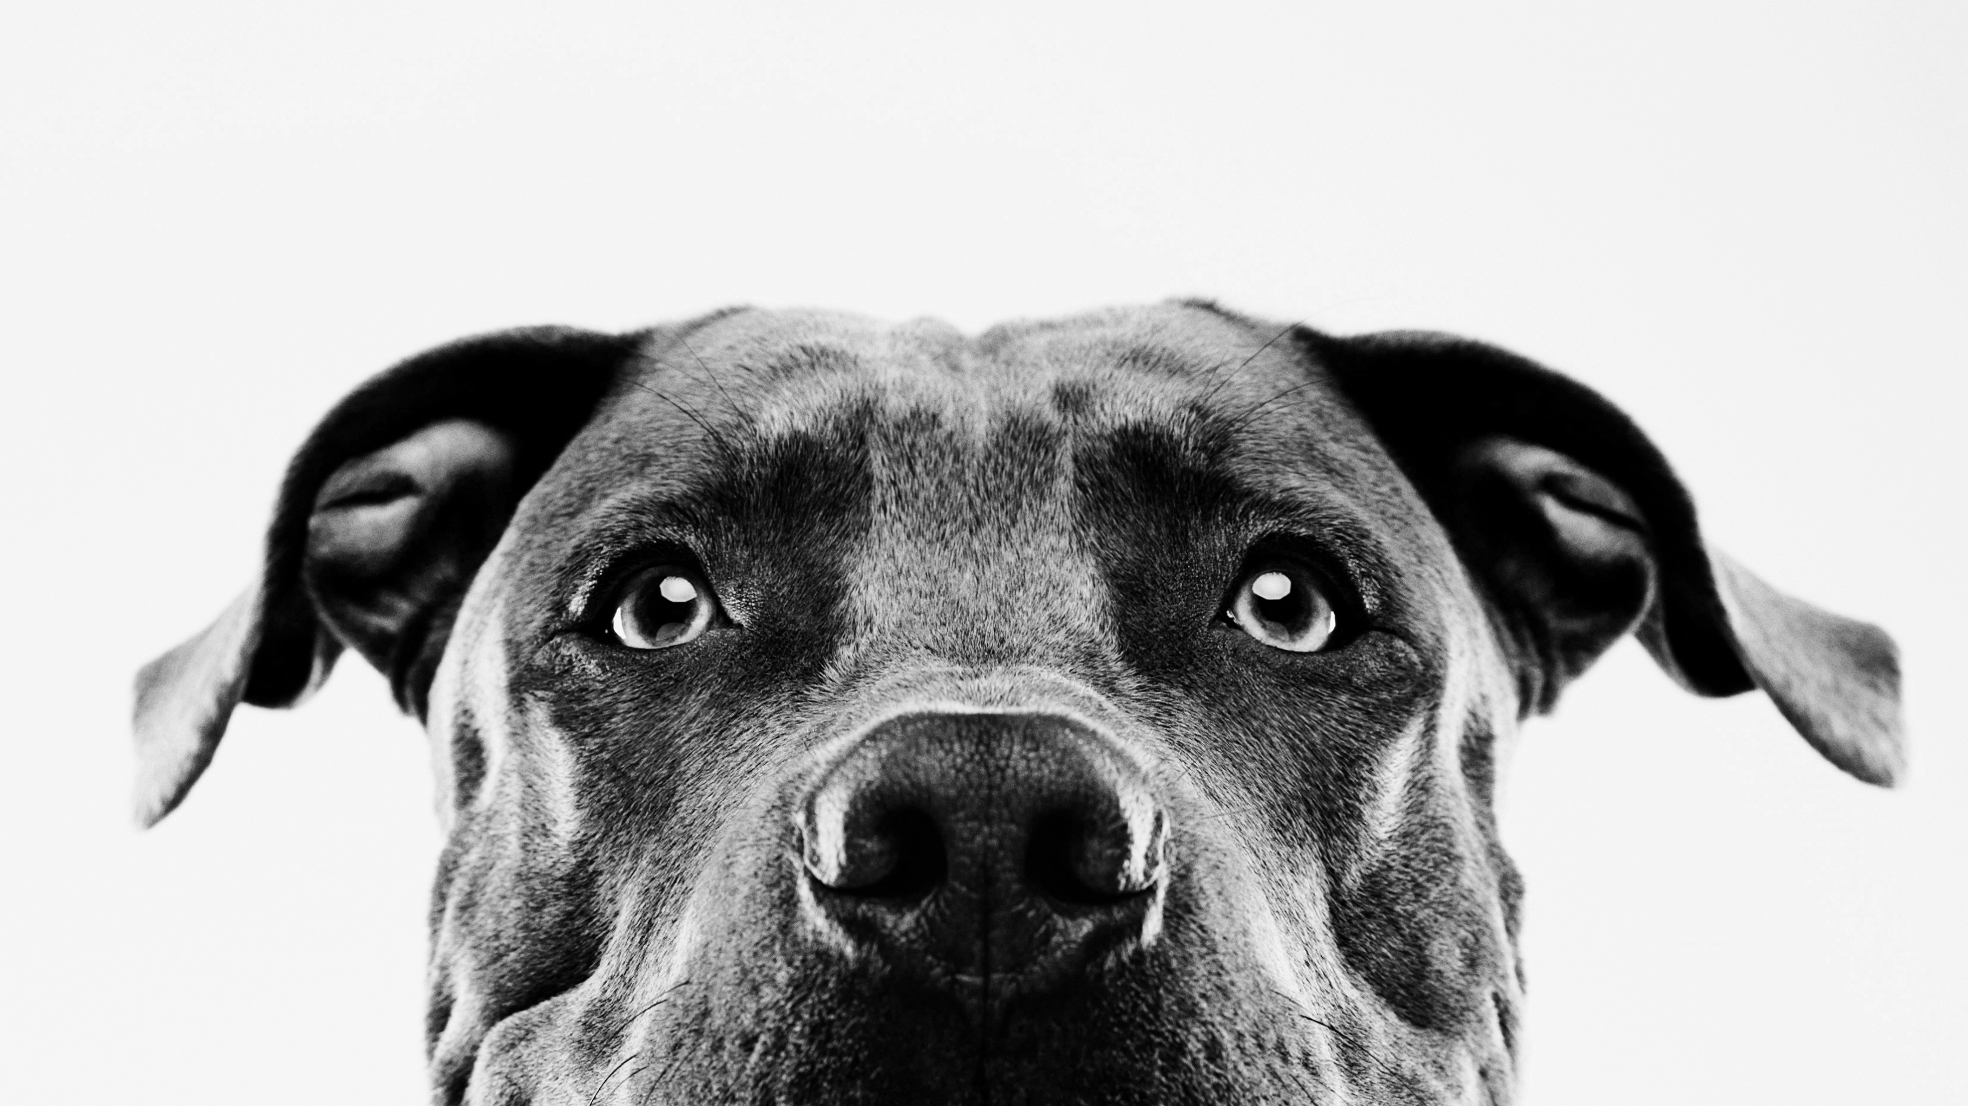
What is possible with dogs breeds, their intelligence and machine learning.
Lauren Emily dedmon

Slide 2
Lauren Emily Dedmon
Currently live in Dallas, Texas
Health and Science have been my passion
New Passion in Data Science, Machine Learning, and Tableau
Want to be a part of bringing new breakthroughs for people and Businesses

Slide 3

Education Colorado Technical University-Heath and Science Degree Bethel School of Technology-Data Science Tableau-Desktop 1 : Fundamentals and Art of Visualization Professional Experience Champion Physical Therapy-Intern Forsyth county parks and Rec centers Orange Theory fitness Project Management Leadership Educator Health Coach

Slide 4
Project Introduction
Dog Breeds, the significance of their intelligence based on their training capabilities and possibly genetics.

Slide 5
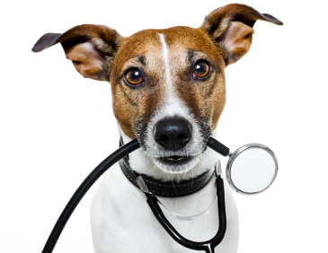
Key terms
Dog Breeds-Various types of Dogs
Lower Reps -lower limit of repetitions to understand new commands
Upper Reps- upper limit of repetitions to understand new commands
Intelligence- the ability to acquire and apply knowledge and skills.
Obey-probability that the breed obeys the first command (figure is lower bound)
Classification-Categories in which the dog breeds are classified based on their intelligence and rep count.
Heterozygosity-Zygosity is the degree in which both copies of the chromosome or gene can have the same genetic sequence. Receiving from both parents of the dogs.

Slide 6
Can you predict the significance of the dog's intelligence based on their classification, how well they obey, and possible traits in their DNA?
The answer is yes…

Slide 7
Components used for project
Python-(Data Wrangling KNN, and Machine Learning
Tableau-Worksheets and Interactive Dashboard

Slide 8
Python
Data Wrangling
Modeling/Machine Learning
Converted all breeds into integers
Recoded classification of breeds based on their percentage and category
Removed missing values
Created a model predicting intelligence using classification, obey, lower and upper reps
Exploring between KNN and Decision tree
Looking at another Data set briefly on Gene and DNA factors for intelligence.
Ruling out size and height for now

Slide 9
Assumptions/Models-Based on Rep counts
KNN-Results-100%
Decision Tree-100%
Works well with smaller data sets
The results were the KNN algorithm predicted which dog breed would be classified by the upper and lower reps.
Intelligence
Classification
Lower Reps
Upper Reps
Obey
Lower Reps(probability on first command)

Slide 10
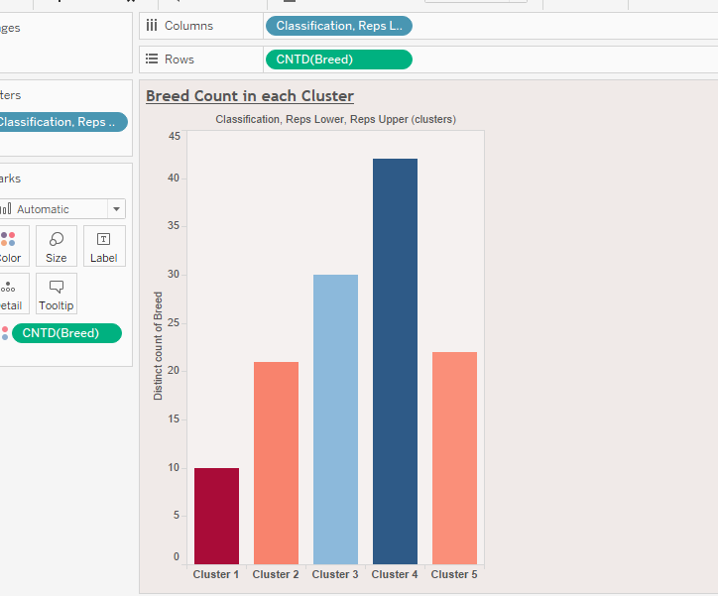
Breed count in different clusters in categories
1.Brightest Dogs
2.Excellent working dogs
3. Above average working dogs
4.Average working dogs
5. Fair working

Slide 11
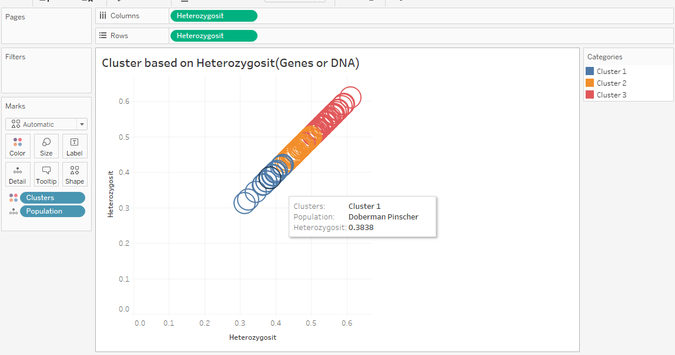
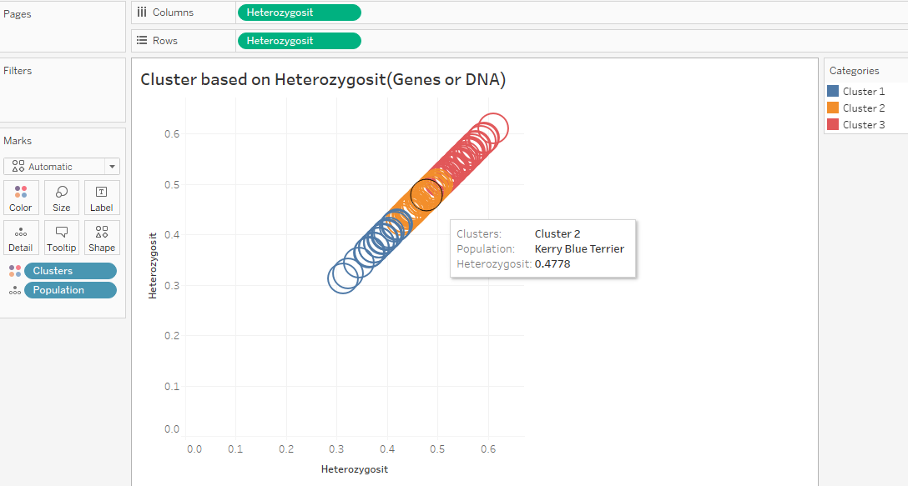
Population and Heterozygosity (Gene or Dna)
Cluster Algorithm
Range or Scale by Numbers

Slide 12
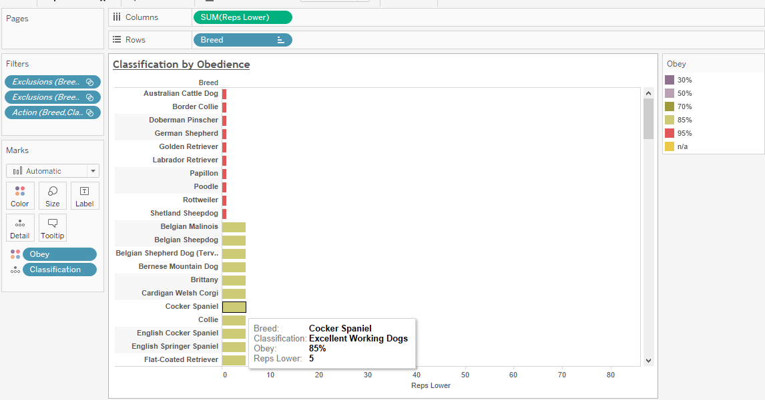
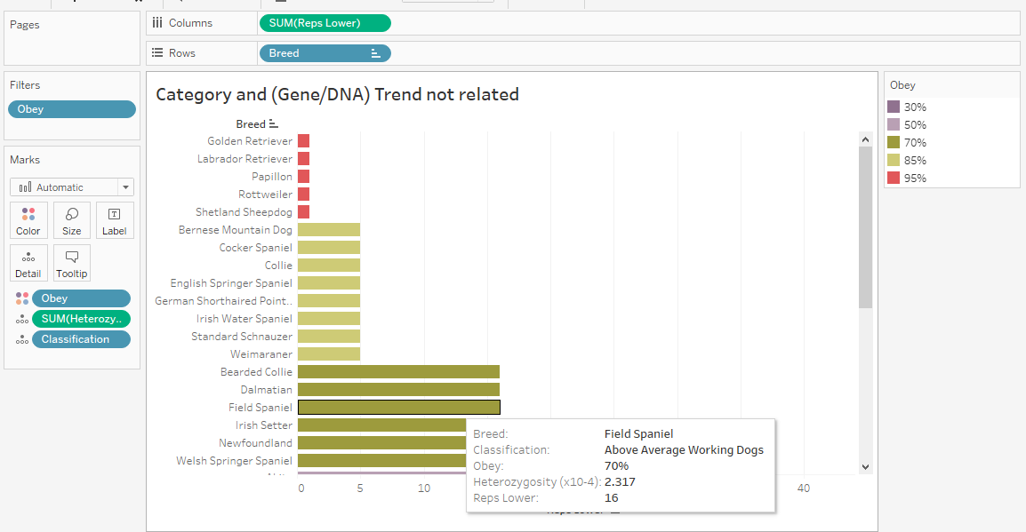
Heterozygosity/related to Categories
Rep Count relates to Category
Heterozygosity does not relate to Category

Slide 13
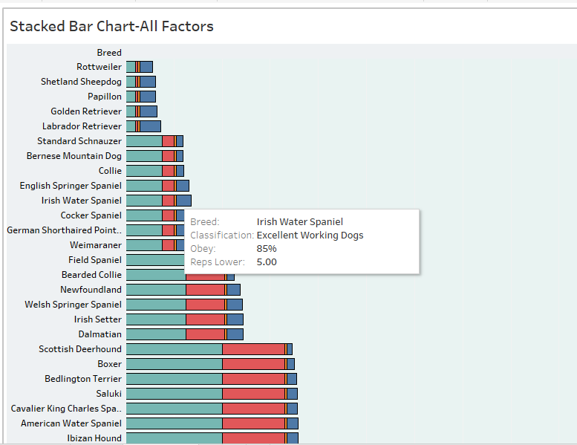
Tableau dashboard
Dog Breeds Classification
Obey ranking
Reps lower and upper
Heterozygosity Count

Slide 14
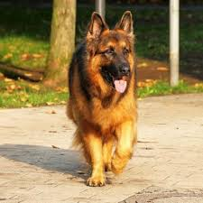
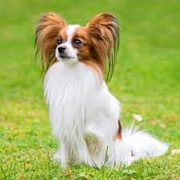
‘Brightest dogs’ category
German Shephard
Papillion

Slide 15
Conclusion
assumptions based on the data would be the intelligence factors of how well the dog responds to training(lower rep count) and how they are categorized.
Considering the gene or dna factor would need further analysis. But because of genetics the dog it could be determined that some intelligence would be passed down from the genes of the certain dog breed.

Slide 16
More time with project
Explore Different Machine learning techniques
Learning Problems
Supervised-This could be useful for putting the intelligent dog breed variables in to help train the lower classification dog breeds.
Unsupervised-This could be useful in connecting what works for the dogs and what doesn’t. then adjust the types of training you could use.
Reinforcement- This would really be helpful in exploring new techniques for all classifications(Dog Breeds) for both the dog and the model and eventually having the model create new techniques to teach the dogs.

Slide 17
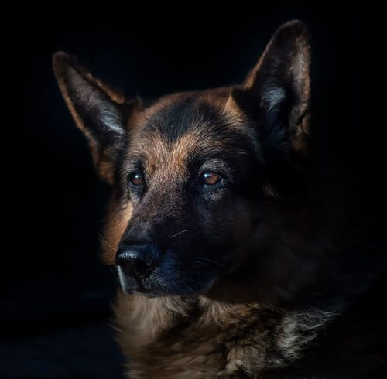
Training models for military, therapy, and work dogs
Creating an algorithm that would match the best dog breed to the right task based on behavioral traits and training capabilities.
Could there be other useful dog breeds that could be used in military training, working class, medicine, or therapy?
Or could we advance how current Military dogs are being trained and create a model that would make them more efficient?
Could we figure out a way to train the lower-class dogs by creating a model that would make them smarter?

Slide 18

RL-Reinforcement Learning
Dog Intelligence/Training Techniques
Agent-based Modeling

Slide 19
Q and A

Slide 20
Resources
Final Project Resources
Data.world
dog_intelligence.csv data dictionary
obey: probability that the breed obeys the first command (figure is lower bound)
reps_lower: lower limit of repetitions to understand new commands
reps_upper: upper limit of repetitions to understand new commands
Dog Intelligence
source: https://en.m.wikipedia.org/wiki/The_Intelligence_of_Dogs#cite_ref-ReferenceA_18-0
https://deepsense.ai/what-is-reinforcement-learning-the-complete-guide/
https://webcache.googleusercontent.com/search?q=cache:YK7rmFwlLSIJ:https://en.wikipedia.org/wiki/Work
ing_dog+&cd=1&hl=en&ct=clnk&gl=us
https://www.python.org/downloads/
iconscout.com-python icon
github.com-Tableau Pic
https://machinelearningmastery.com/types-of-learning-in-machine-learning/
https://www.google.com/search?q=dog+intelligence+pictures&safe=strict&rlz=1C1CHBF_enUS890US890&sxs
rf=ALeKk021VYOAKFS1XIjQDy3f0Nm8aq
U_A:1608044760897&source=lnms&tbm=isch&sa=X&ved=2ahUKEwjo7YXGodDtAhVNAqwKHS1UBZQQ_AUoA3oECA8
QBQ&biw=1366&bih=568#imgrc=elp0ppVtP5ulCM

